Slide 1
Database Management System – Day 2

Slide 2
SQL - Advanced Operations
Sub Queries
Transactions
Develop queries using SQL Joins
Introduction to views and indexes
Stored Procedures
Functions
Triggers
Notes:
1

Slide 3



Using a Subquery to Solve a Problem
Who has a salary greater than Abel’s?
Main query:
Which employees have salaries greater than Abel’s salary?
Subquery:
What is Abel’s salary?
Notes:
Using a Subquery to Solve a Problem
Suppose you want to write a query to find out who earns a salary greater than Abel’s salary.
To solve this problem, you need two queries: one to find how much Abel earns, and a second query to find who earns more than that amount.
You can solve this problem by combining the two queries, placing one query inside the other query.
The inner query (or subquery) returns a value that is used by the outer query (or main query). Using a subquery is equivalent to performing two sequential queries and using the result of the first query as the search value in the second query.

Slide 4
Subquery Syntax
The subquery (inner query) executes once before the main query (outer query).
The result of the subquery is used by the main query.
SELECT select_list
FROM table
WHERE expr operator
(SELECT select_list
FROM table);
Notes:
Subquery Syntax
A subquery is a SELECT statement that is embedded in a clause of another SELECT statement. You can build powerful statements out of simple ones by using subqueries. They can be very useful when you need to select rows from a table with a condition that depends on the data in the table itself.
You can place the subquery in a number of SQL clauses, including the following:
WHERE clause
HAVING clause
FROM clause
In the syntax:
operator includes a comparison condition such as >, =, or IN
Note: Comparison conditions fall into two classes: single-row operators (>, =, >=, <, <>, <=) and multiple-row operators (IN, ANY, ALL).
The subquery is often referred to as a nested SELECT, sub-SELECT, or inner SELECT statement. The subquery generally executes first, and its output is used to complete the query condition for the main (or outer) query.

Slide 5
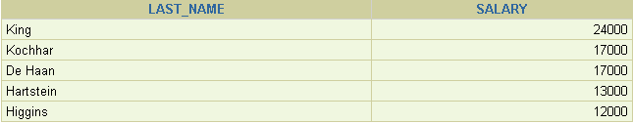
Using a Subquery
SELECT last_name, salary
FROM employees
WHERE salary >
(SELECT salary
FROM employees
WHERE last_name = 'Abel');
11000
Notes:
Using a Subquery
In the slide, the inner query determines the salary of employee Abel. The outer query takes the result of the inner query and uses this result to display all the employees who earn more than this amount.

Slide 6
Guidelines for Using Subqueries
Enclose subqueries in parentheses.
Place subqueries on the right side of the comparison condition.
Use single-row operators with single-row subqueries, and use multiple-row operators with multiple-row subqueries.
Notes:
Guidelines for Using Subqueries
A subquery must be enclosed in parentheses.
Place the subquery on the right side of the comparison condition for readability.
With Oracle8i and later releases, an ORDER BY clause can be used and is required in the subquery to perform Top-N analysis.
Before Oracle8i, however, subqueries could not contain an ORDER BY clause. Only one ORDER BY clause could be used for a SELECT statement; if specified, it had to be the last clause in the main SELECT statement.
Two classes of comparison conditions are used in subqueries: single-row operators and multiple-row operators.

Slide 7
Types of Subqueries
Single-row subquery
Multiple-row subquery
Main query
Subquery
returns
ST_CLERK
Main query
Subquery
returns
ST_CLERK
SA_MAN
Notes:
Types of Subqueries
Single-row subqueries: Queries that return only one row from the inner SELECT statement
Multiple-row subqueries: Queries that return more than one row from the inner SELECT statement
Note: There are also multiple-column subqueries, which are queries that return more than one column from the inner SELECT statement. These are covered in the Oracle Database 11g: SQL Fundamentals II course.

Slide 8
Single-Row Subqueries
Return only one row
Use single-row comparison operators
Operator | Meaning
= | Equal to
> | Greater than
>= | Greater than or equal to
< | Less than
<= | Less than or equal to
<> | Not equal to
Notes:
Single-Row Subqueries
A single-row subquery is one that returns one row from the inner SELECT statement. This type of subquery uses a single-row operator. The slide gives a list of single-row operators.
Example
Display the employees whose job ID is the same as that of employee 141:
SELECT last_name, job_id
FROM employees
WHERE job_id =
(SELECT job_id
FROM employees
WHERE employee_id = 141);

Slide 9

Executing Single-Row Subqueries
SELECT last_name, job_id, salary
FROM employees
WHERE job_id =
(SELECT job_id
FROM employees
WHERE employee_id = 141)
AND salary >
(SELECT salary
FROM employees
WHERE employee_id = 143);
ST_CLERK
2600
Notes:
Executing Single-Row Subqueries
A SELECT statement can be considered as a query block. The example in the slide displays employees whose job ID is the same as that of employee 141 and whose salary is greater than that of employee 143.
The example consists of three query blocks: the outer query and two inner queries. The inner query blocks are executed first, producing the query results ST_CLERK and 2600, respectively. The outer query block is then processed and uses the values that were returned by the inner queries to complete its search conditions.
Both inner queries return single values (ST_CLERK and 2600, respectively), so this SQL statement is called a single-row subquery.
Note: The outer and inner queries can get data from different tables.

Slide 10
Using Group Functions in a Subquery
SELECT last_name, job_id, salary
FROM employees
WHERE salary =
(SELECT MIN(salary)
FROM employees);
2500
Notes:
Using Group Functions in a Subquery
You can display data from a main query by using a group function in a subquery to return a single row. The subquery is in parentheses and is placed after the comparison condition.
The example in the slide displays the employee last name, job ID, and salary of all employees whose salary is equal to the minimum salary. The MIN group function returns a single value (2500) to the outer query.

Slide 11
The HAVING Clause with Subqueries
The server executes subqueries first.
The server returns results into the HAVING clause of the main query.
SELECT department_id, MIN(salary)
FROM employees
GROUP BY department_id
HAVING MIN(salary) >
(SELECT MIN(salary)
FROM employees
WHERE department_id = 50);
2500
Notes:
The HAVING Clause with Subqueries
You can use subqueries not only in the WHERE clause but also in the HAVING clause. The Oracle server executes the subquery, and the results are returned into the HAVING clause of the main query.
The SQL statement in the slide displays all the departments that have a minimum salary greater than that of department 50.
Example
Find the job with the lowest average salary.
SELECT job_id, AVG(salary)
FROM employees
GROUP BY job_id
HAVING AVG(salary) = (SELECT MIN(AVG(salary))
FROM employees
GROUP BY job_id);

Slide 12
What Is Wrong with This Statement?
SELECT employee_id, last_name
FROM employees
WHERE salary =
(SELECT MIN(salary)
FROM employees
GROUP BY department_id);
ERROR at line 4:
single-row subquery returns more than one row
Single-row operator with multiple-row subquery
Notes:
Errors with Subqueries
One common error with subqueries occurs when more than one row is returned for a single-row subquery.
In the SQL statement in the slide, the subquery contains a GROUP BY clause, which implies that the subquery will return multiple rows, one for each group that it finds. In this case, the result of the subquery are 4400, 6000, 2500, 4200, 7000, 17000, and 8300.
The outer query takes those results and uses them in its WHERE clause. The WHERE clause contains an equal (=) operator, a single-row comparison operator that expects only one value. The = operator cannot accept more than one value from the subquery and, therefore, generates the error.
To correct this error, change the = operator to IN.

Slide 13
Will This Statement Return Rows?
SELECT last_name, job_id
FROM employees
WHERE job_id =
(SELECT job_id
FROM employees
WHERE last_name = 'Haas');
no rows selected
Subquery returns no values.
Notes:
Problems with Subqueries
A common problem with subqueries occurs when no rows are returned by the inner query.
In the SQL statement in the slide, the subquery contains a WHERE clause. Presumably, the intention is to find the employee whose name is Haas. The statement is correct but selects no rows when executed.
There is no employee named Haas. So the subquery returns no rows. The outer query takes the results of the subquery (null) and uses these results in its WHERE clause. The outer query finds no employee with a job ID equal to null, and so returns no rows. If a job existed with a value of null, the row is not returned because comparison of two null values yields a null; therefore, the WHERE condition is not true.

Slide 14
Multiple-Row Subqueries
Return more than one row
Use multiple-row comparison operators
Operator | Meaning
IN | Equal to any member in the list
ANY | Compare value to each value returned by the subquery
ALL | Compare value to every value returned by the subquery
Notes:
Multiple-Row Subqueries
Subqueries that return more than one row are called multiple-row subqueries. You use a multiple-row operator, instead of a single-row operator, with a multiple-row subquery. The multiple-row operator expects one or more values:
SELECT last_name, salary, department_id
FROM employees
WHERE salary IN (SELECT MIN(salary)
FROM employees
GROUP BY department_id);
Example
Find the employees who earn the same salary as the minimum salary for each department.
The inner query is executed first, producing a query result. The main query block is then processed and uses the values that were returned by the inner query to complete its search condition. In fact, the main query appears to the Oracle server as follows:
SELECT last_name, salary, department_id
FROM employees
WHERE salary IN (2500, 4200, 4400, 6000, 7000, 8300, 8600, 17000);

Slide 15
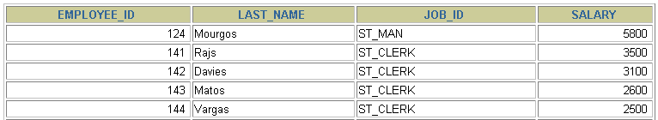
Using the ANY Operator in Multiple-Row Subqueries
SELECT employee_id, last_name, job_id, salary
FROM employees
WHERE salary < ANY
(SELECT salary
FROM employees
WHERE job_id = 'IT_PROG')
AND job_id <> 'IT_PROG';
9000, 6000, 4200
…
Notes:
Multiple-Row Subqueries (continued)
The ANY operator (and its synonym, the SOME operator) compares a value to each value returned by a subquery. The slide example displays employees who are not IT programmers and whose salary is less than that of any IT programmer. The maximum salary that a programmer earns is $9,000.
<ANY means less than the maximum. >ANY means more than the minimum. =ANY is equivalent to IN.

Slide 16
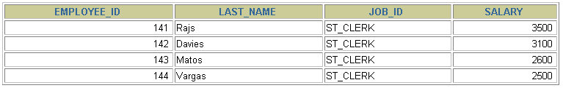
Using the ALL Operator in Multiple-Row Subqueries
SELECT employee_id, last_name, job_id, salary
FROM employees
WHERE salary < ALL
(SELECT salary
FROM employees
WHERE job_id = 'IT_PROG')
AND job_id <> 'IT_PROG';
9000, 6000, 4200
Notes:
Multiple-Row Subqueries (continued)
The ALL operator compares a value to every value returned by a subquery. The slide example displays employees whose salary is less than the salary of all employees with a job ID of IT_PROG and whose job is not IT_PROG.
>ALL means more than the maximum, and <ALL means less than the minimum.
The NOT operator can be used with IN, ANY, and ALL operators.

Slide 17
Null Values in a Subquery
SELECT emp.last_name
FROM employees emp
WHERE emp.employee_id NOT IN
(SELECT mgr.manager_id
FROM employees mgr);
no rows selected
Notes:
Returning Nulls in the Resulting Set of a Subquery
The SQL statement in the slide attempts to display all the employees who do not have any subordinates. Logically, this SQL statement should have returned 12 rows. However, the SQL statement does not return any rows. One of the values returned by the inner query is a null value, and, therefore, the entire query returns no rows.
The reason is that all conditions that compare a null value result in a null. So whenever null values are likely to be part of the results set of a subquery, do not use the NOT IN operator. The NOT IN operator is equivalent to <> ALL.
Notice that the null value as part of the results set of a subquery is not a problem if you use the IN operator. The IN operator is equivalent to =ANY. For example, to display the employees who have subordinates, use the following SQL statement:
SELECT emp.last_name
FROM employees emp
WHERE emp.employee_id IN
(SELECT mgr.manager_id
FROM employees mgr);

Slide 18
Joins
To avoid cartesian products as a result of query from multiple tables, we use Joins.
Joins are conditions that are applied in a where clause.
Joins are of various types
Equijoin / Natural Joins
Non Equijoin
Self Join
Cross Join
Inner Joins
Outer Joins

Slide 19
Joins
Equijoins : This type of a Join mostly involves Primary and foreign key compliments with a = operator
Select employee.employee_id, employee.first_name, employee.last_name,departments.department_id from
employee,departments
where employee.department_id=departments.department_id
Non Equijoins : This type of a join is used when we do not use = operator
Select e.last_name,e.salary,j.grade_level
from employee e, job_grade j
where e.salary between j.lowest_sal and j.highest_sal
Self joins : This type of join is used to join a single table with itself
Select e1.last_name || ‘works for’ || e2.last_name
from employee e1, employee e2
where e1.manager_id=e2.employee_id

Slide 20
Joins
Outer Join : This type of join is used to retrieve non direct matching rows from one table using a ‘+’ sign
Select e.last_name,e.department_id,
d.department_name from employee e, departments d
Where e.department_id(+)=d.department_id
Cross Join : This is used to produce cartesian products
Select last_name,department_name
from employees,department (or)
Select last_name,department_name
from employees
Cross join departments

Slide 21
Joins
Inner Joins : Similar to Equi/natural joins that returns only matched records
Left Outer Join
A join between 2 tables that returns the results of the inner join as well as unmatched rows from the left table
Eg : select e.last_name, e.department_id,d.department_name
from employee e left outer join departments d
on (e.department_id=d.department_id)

Slide 22
Joins
Right Outer Join
A join between 2 tables that returns the results of the inner join as well as unmatched rows from the right table
Eg : select e.last_name, e.department_id,d.department_name
from employee e right outer join departments d
on (e.department_id=d.department_id)

Slide 23
Joins
Full Outer Join :
A join between 2 tables that returns the results of the inner join as well as the results of a left and right join
Eg : select e.last_name, e.department_id,d.department_name
from employee e full outer join departments d
on (e.department_id=d.department_id)

Slide 24
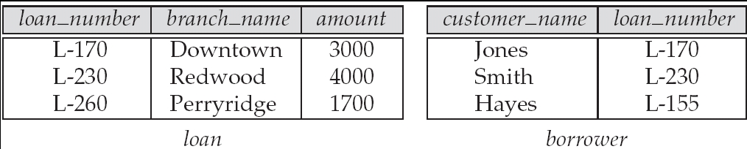
Joined Relations – Datasets for Examples
Relation loan
Relation borrower
Note: borrower information missing for L-260 and loan information missing for L-155

Slide 25
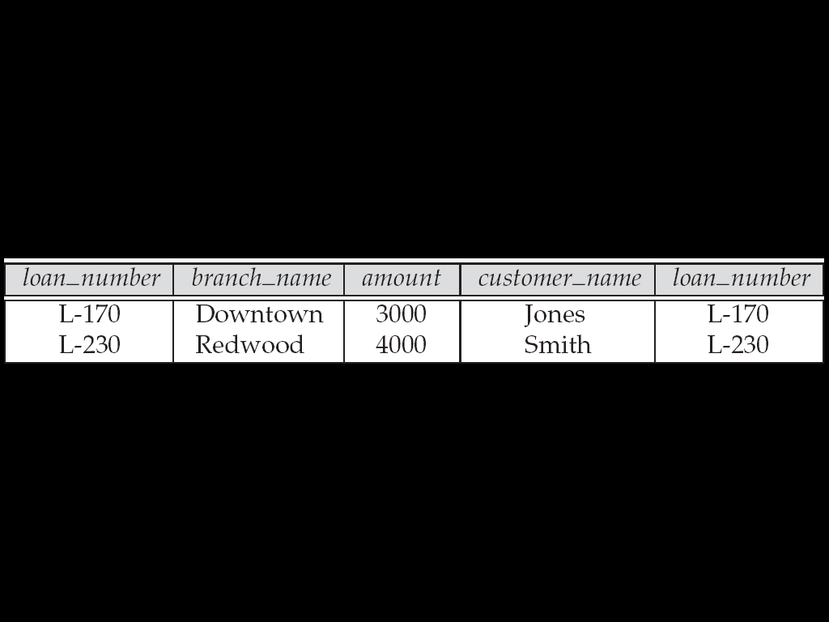
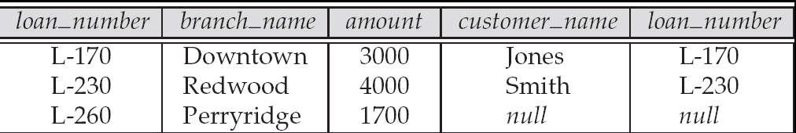
Joined Relations – Examples
loan inner join borrower on loan.loan_number = borrower.loan_number
loan left outer join borrower on loan.loan_number = borrower.loan_number

Slide 26
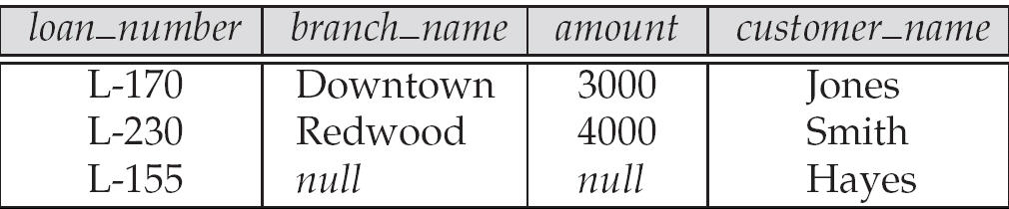
Joined Relations – Examples
loan natural inner join borrower
loan natural right outer join borrower

Slide 27
Transaction Management
A Database transaction consists of one of the following
DML Statement/s which constitutes one consistent change
One DDL statement
One DCL statement
Begins when the first DML statement is executed
Ends with one of the following events
A Commit or a Rollback statement
A DDL or a DCL statement executed(auto commit)
The user exits
The system crashes

Slide 28
Transaction Management
With Commit and Rollback statements, one can ensure
Data Consistency
Preview data changes before making changes permanent
Group logically related operations
Save Points
Are logical blocks/markers of set operations in a transaction.
It is not ANSI standard SQL

Slide 29
Controlling Transactions
Time
Transaction
Delete
SavePoint A
Insert
Update
Savepoint B
Insert
Rollback to savepoint B
Rollback to savepoint A
Rollback

Slide 30
State of Data before Commit or Rollback
The previous state of the data can be recovered
The current user can review the results using select statements
Other users cannot view the results of the DML statements by the current user
The affected rows are locked. Other users cannot change the data

Slide 31
A sample Transaction
BEGIN
UPDATE emp_information
SET emp_dept='Web Developer‘
WHERE emp_name='Saulin';
COMMIT;
END;

Slide 32
Sample
Begin
insert into emp (empno,ename,sal) values (109,’Sami’,3000); save transaction a; insert into dept values (10,’Sales’,’Hyd’); save transaction b; insert into salgrade values (‘III’,9000,12000);
rollback to a;
Then row from salgrade table and dept will be roll backed. At this point you can commit the row inserted into emp table or rollback the transaction.
rollback to b;
Then row inserted into salgrade table will be roll backed. At this point you can commit the row inserted into dept table and emp table or rollback to savepoint a or completely roll back the transaction.
rollback;
Then the whole transactions is roll backed.
commit;
Then the whole transaction is committed and all savepoints are removed.
End

Slide 33
Introduction to views
A relation that is not of the conceptual model but is made visible to a user as a “virtual relation” is called a view.
A view is defined using the create view statement which has the form
create view v as < query expression >
where <query expression> is any legal SQL expression. The view name is represented by v.
Once a view is defined, the view name can be used to refer to the virtual relation that the view generates.

Slide 34
Example Queries
A view consisting of branches and their customers
create view all_customer as (select branch_name, customer_name from depositor, account where depositor.account_number =
account.account_number )
union (select branch_name, customer_name from borrower, loan where borrower.loan_number = loan.loan_number )
Find all customers of the Perryridge branch
select customer_name from all_customer where branch_name = 'Perryridge'

Slide 35
Uses of Views
Hiding some information from some users
Consider a user who needs to know a customer’s name, loan number and branch name, but has no need to see the loan amount.
Define a view (create view cust_loan_data as select customer_name, borrower.loan_number, branch_name from borrower, loan where borrower.loan_number = loan.loan_number )
Grant the user permission to read cust_loan_data, but not borrower or loan

Slide 36
Update of a View
Create a view of all loan data in the loan relation, hiding the amount attribute
create view loan_branch as select loan_number, branch_name from loan
Add a new tuple to loan_branch
insert into loan_branch values ('L-37‘, 'Perryridge‘)
This insertion must be represented by the insertion of the tuple
('L-37', 'Perryridge', null )
into the loan relation

Slide 37
Updates Through Views (Cont.)
Some updates through views are impossible to translate into updates on the database relations
create view v as select loan_number, branch_name, amount from loan where branch_name = ‘Perryridge’
insert into v values ( 'L-99','Downtown', '23')
Others cannot be translated uniquely
Most SQL implementations allow updates only on simple views (without aggregates) defined on a single relation

Slide 38
Stored Procedures
RAISERROR statement | THROW statement
If a msg_id is passed to RAISERROR, the ID must be defined in sys.messages. | The error_number parameter does not have to be defined in sys.messages.
The msg_str parameter can contain printf formatting styles. | The message parameter does not accept printf style formatting.
The severity parameter specifies the severity of the exception. | There is no severity parameter. The exception severity is always set to 16.

Slide 39
FUNCTIONS
There are three Types of UDFS in Sql Server: 1. Scalar 2. Inline Table-Valued 3. Multi-statement Table-Valued

Slide 40
Scalar User-Defined Function
A Scalar UDF can accept 0 to many input parameter and will return a single value. A Scalar user-defined function returns one of the scalar (int, char, varchar etc) data types. Text, ntext, image and timestamp data types are not supported. These are the type of user-defined functions that most developers are used to in other programming languages.

Slide 41
Inline Table-Valued User-Defined Function
An inline table-valued function returns a variable of data type table whose value is derived from a single SELECT statement. Since the return value is derived from the SELECT statement, there is no BEGIN/END block needed in the CREATE FUNCTION statement. There is also no need to specify the table variable name (or column definitions for the table variable) because the structure of the returned value is generated from the columns that compose the SELECT statement. Because the results are a function of the columns referenced in the SELECT, no duplicate column names are allowed and all derived columns must have an associated alias.

Slide 42
Multi-statement Table-Valued User-Defined Function
A Multi-Statement Table-Valued user-defined function returns a table. It can have one or more than one T-Sql statement. Within the create function command you must define the table structure that is being returned. After creating this type of user-defined function, we can use it in the FROM clause of a T-SQL command unlike the behavior found when using a stored procedure which can also return record sets.

